Slide 1
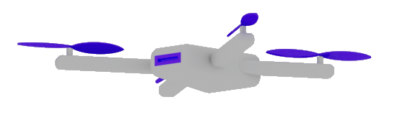

GenAI unpacked: Beyond Basics
https://www.linkedin.com/in/damirdobric/
Dr. Damir Dobric
Lead Software Architect daenet GmbH / ACP Digital
Microsoft Regional Director,
Most Valuable Professional: AI

Slide 2
AGENDA
Tokens
Embeddings
Vector DBs
RAG
Function Calling
Semantic Kernel

Slide 3
TOKENS

Slide 4

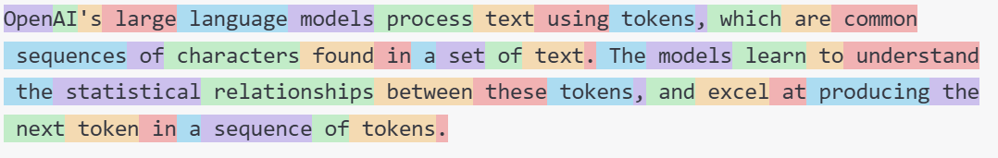
What are Tokens?
1 token ~= 4 chars in English
1 token ~= ¾ words
100 tokens ~= 75 words
Byte Pare Encoding (Gage,1994): Wikipedia
What are tokens and how to count them?
Token Pricing: Pricing (openai.com)

Slide 5
DEMO
Tokenizer
Creating tokens in C#

Slide 6
EMBEDDINGS

Slide 7
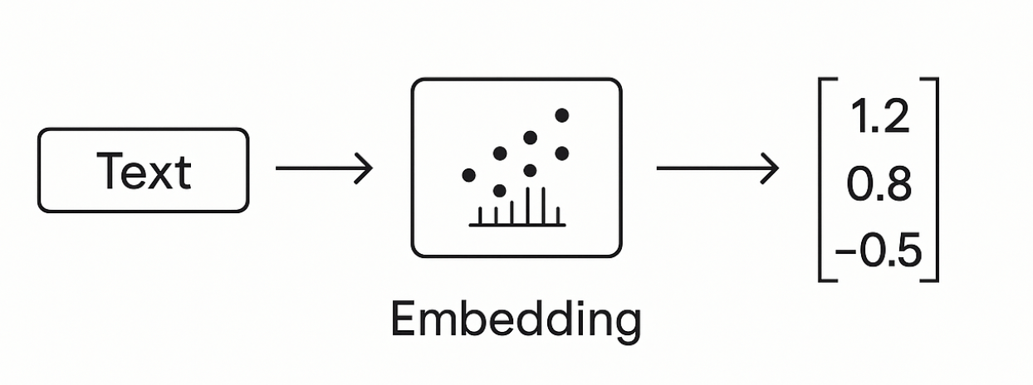
Embeddings
Making a vector from text

Slide 8
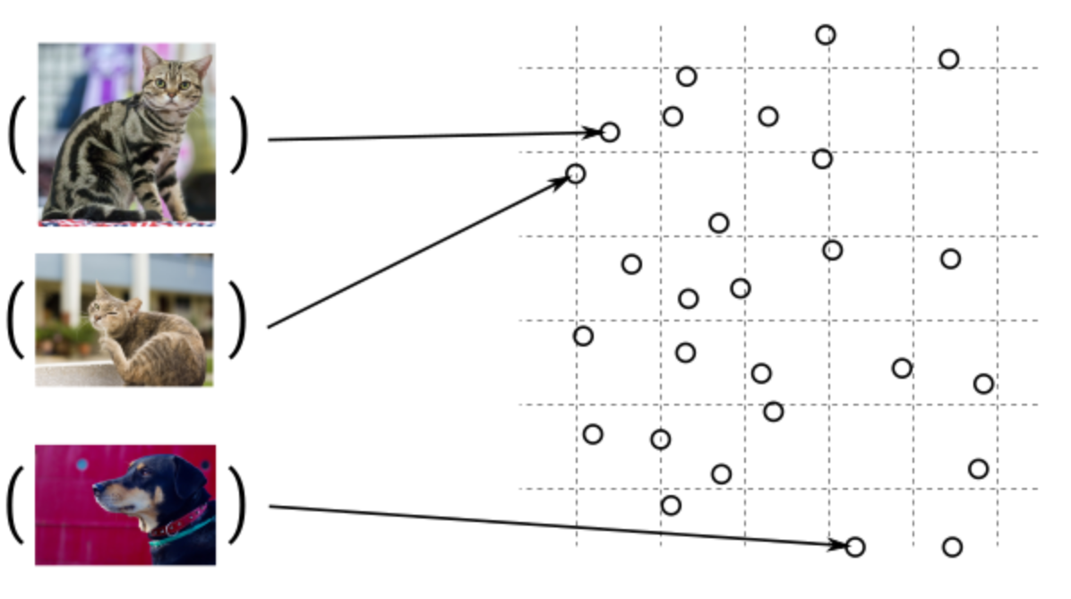
Guess, today is a nice day in Palma
Embedding Models
Today is a typical German rainy day
Two things are infinite: the universe and human stupidity; and I'm not sure about the universe.

Slide 9

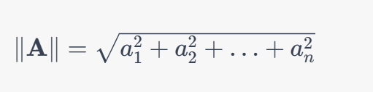
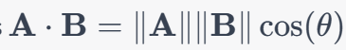
Similarity Between Multidimensional Vectors
Dot Product
The Norm
Cosine Similarity

Slide 10
When to use Embeddings?
Semantic Search
Classification
Clustering
Recommendations
. . .

Slide 11
DEMO
Consuming Embedding Model with HTTP/Post
Creating Embeddings in C#

Slide 12
VECTOR DATABASES

Slide 13
Vector DBs
SqlServer 2025 Native Vector Search
Quadrant
CosmosDB
…

Slide 14
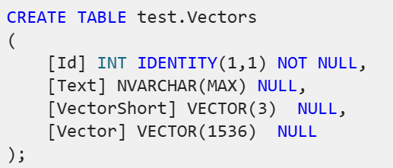
SqlServer 2025 Native Vector Search
SqlServer 2025 Native Vector Search
In Azure
On-Prem
SQL Server Native Vector Search for .NET Developers

Slide 15
DEMO
SQL Server Native Vector Search
SQL Server Native Vector
DECLARE @v1 VECTOR(2) = '[1,1]';
DECLARE @v2 VECTOR(2) = '[-1,-1]';
SELECT
VECTOR_DISTANCE('euclidean', @v1, @v2) AS euclidean,
VECTOR_DISTANCE('cosine', @v1, @v2) AS cosine,
VECTOR_DISTANCE('dot', @v1, @v2) AS negative_dot_product;

Slide 16
COMPLETION MODELS
How does all this work?

Slide 17
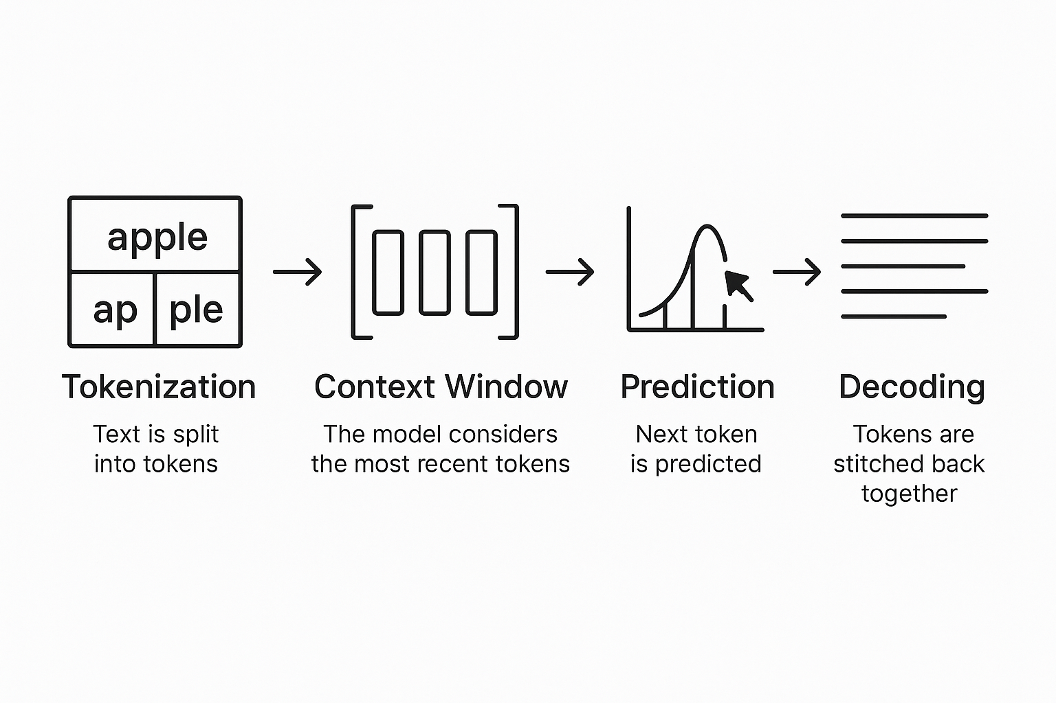
Completion Models
Text Completion Flow

Slide 18

DEMO
C# Application
Using OpenAI nuget package
Executing ChatCompletions
Presenting Probabilities

Slide 19
A Scientific look under the hub

Slide 20
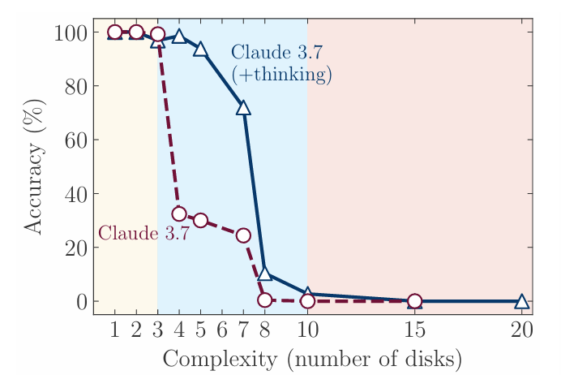
Model Performance and Illusion of Tinking
LiveBench
ml-site.cdn-apple.com/papers/the-illusion-of-thinking.pdf

Slide 21
RAG Retrieval Augmented Generation

Slide 22
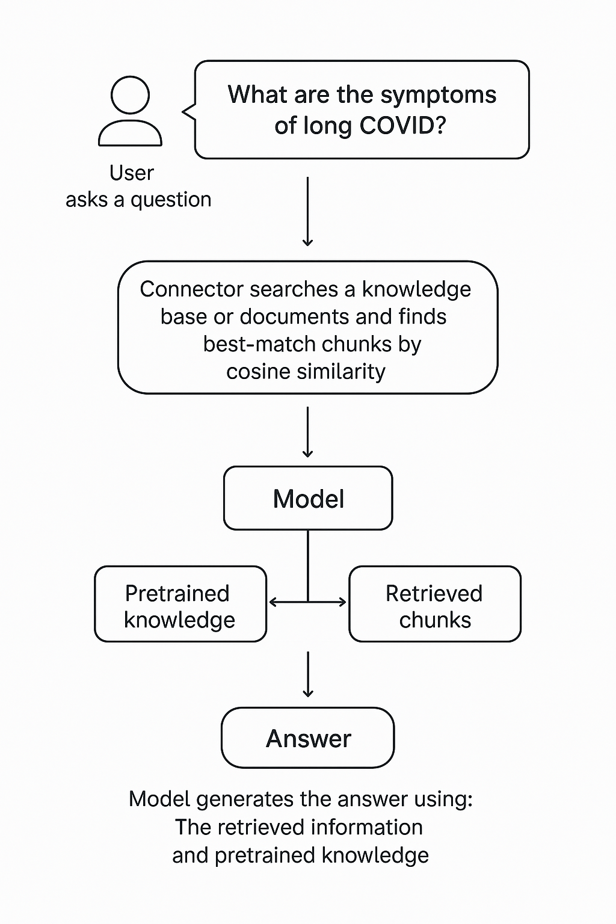
RAG Retrieval-Augmented Generation
Extending the model knowledge
Combines information retrieval with text generation
https://arxiv.org/abs/2005.11401

Slide 23
DEMO (c#)
Creating chunks
Creating embeddings
InMemory Vector DB
Calculating Similarity

Slide 24
Function Calling

Slide 25



Chat Model Interaction
User: How are you?
(1)
AI
Prompt
(2)
Assistent: I‘m fine, ho wcan I help you

Slide 26

Function Calling
User: Switch on the light to green.
LichtPlugin
SwitchLightOn(color)
SwitychLightOff
(1)
WeatherPlugin
ShowInfo(Location)
AI
Prompt
(2)
My Database
Tool: SwitchLightOn(green)
Schritt 2:
KI ermittelt aus dem Prompt die passende Funktion und Argumente. Bsp.:
SchallteLichAn(grün)
Plugin Library
Enthält die Beschreibungen von Funktionen.

Slide 27
Function Calling
{
"type": "function",
"function": {
"name": "get_weather",
"description": "Retrieves current weather for the given location.",
"strict": true,
"parameters": {
"type": "object",
"properties": {
"location": {
"type": "string",
"description": "City and country e.g. Bogotá, Colombia"
},
"units": {
"type": ["string", "null"],
"enum": ["celsius", "fahrenheit"],
"description": "Units the temperature will be returned in."
}
},
"required": ["location", "units"],
"additionalProperties": false
}
}
}

Slide 28
Function Calling
User: Set the light on green?
(1)
(1)
Service
KI
PlugInLIbrary
(2)
(5)
Prompt
(3)
(4)
Licht Connector (API)
Tool: SetLight(green)
Schritt 2:
KI ermittelt aus dem Prompt die passende Funktion und Argumente. Bsp.:
SchallteLichAn(grün)
Plugin Library
Enthält die Beschreibungen von Funktionen.

Slide 29
GenAI unpacked: Beyond Basics
THANK YOU ☺
https://www.linkedin.com/in/damirdobric/
Dr. Damir Dobric
Lead Software Architect daenet GmbH / ACP Digital
Microsoft Regional Director,
Most Valuable Professional: AI

